Slide 1
JAVA PROJECT
Batch :- SDA-FSD-01-02
Session 2022-23
Online Shopping
Md Shoiab
Makarand Nikam
Rohan Chavan
Shashikant Gund
Rushikesh Borhade
Devendra Patil

Slide 2
INDEX
Introduction
Problem Statement & Benefits
Online Shopping Process
Objectives
Literature Survey
Plan of Action
Data Flow Diagram
Project Status
Future Scope
Conclusion

Slide 3
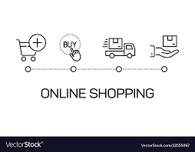
INTRODUCTION
Shopping is one of the essential part of our daily life. We’re using different type of shops to buy different kind of things everyday.
Today our life is divided into two parts :-
Physical life : We met everyone physically
Virtual life : We met people on a virtual world called ‘Internet’ .

Slide 4
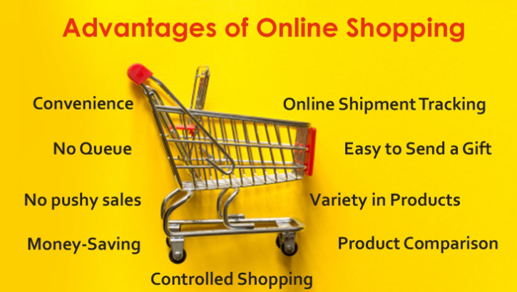
Problem Statement and Benefits of Online Shopping
Efficiency : You can access and manage all your shopping from secure site.
Transaction : Online Shopping sites generally execute and confirm transaction at or quicker than ATM processing speeds.

Slide 5
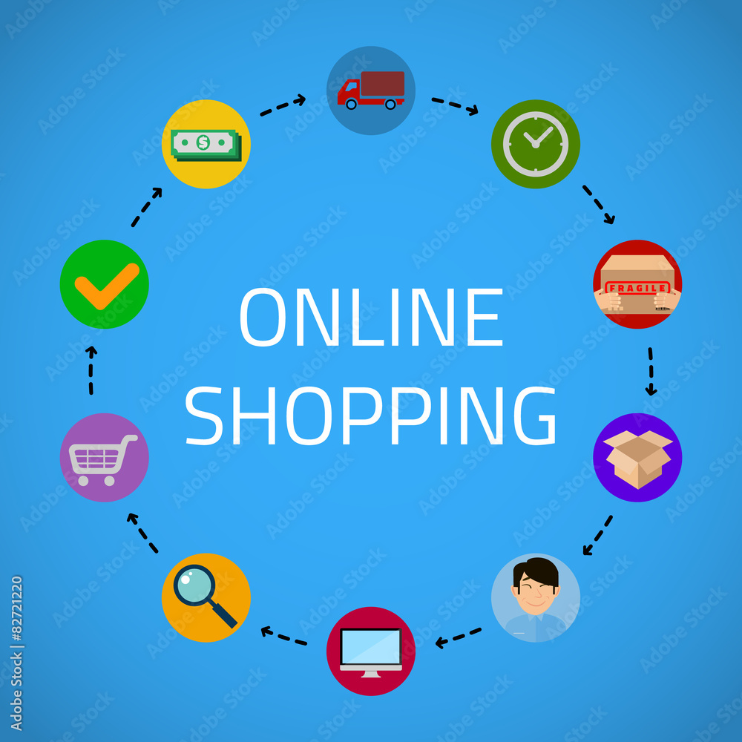
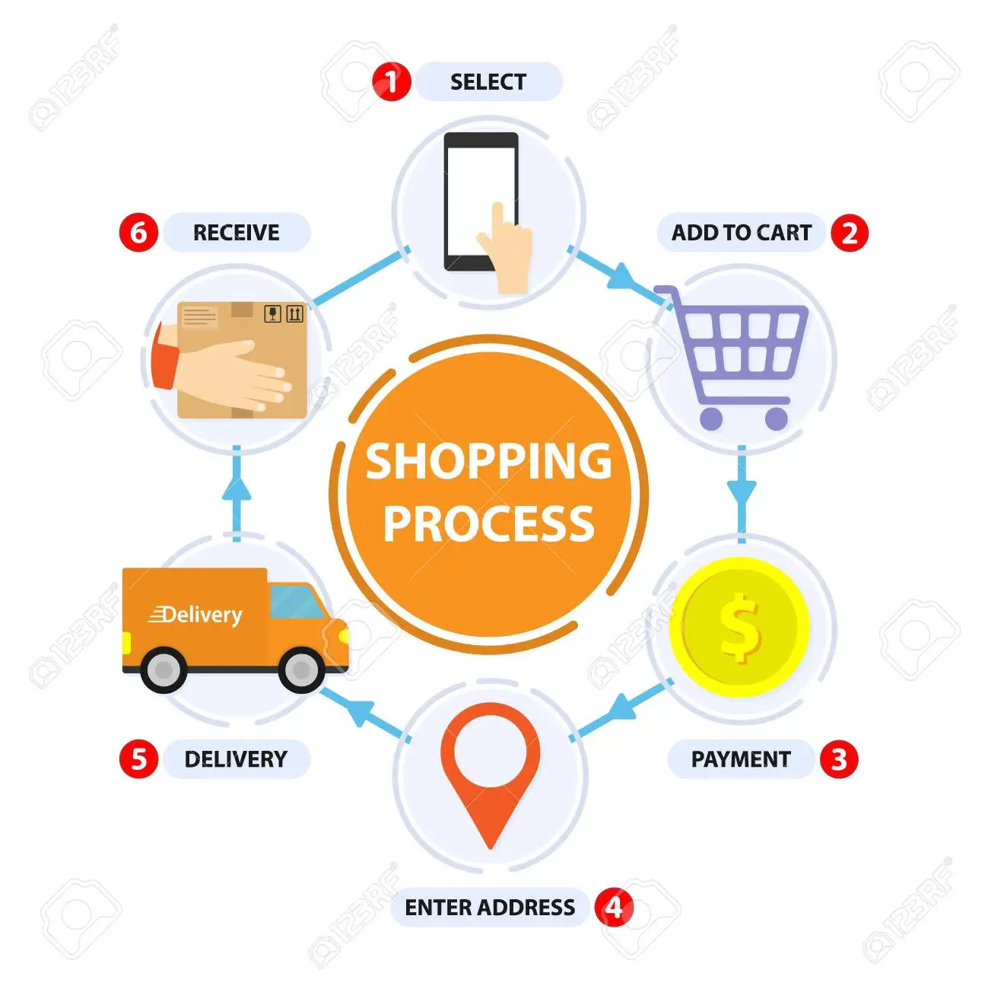
Online Shopping Process

Slide 6
OBJECTIVES
To know the customer satisfaction for retailers .
To measure level of satisfaction of the selected retailers.
To study the comparatively analyze customer satisfaction for those retailers.
To study the consumer satisfaction towards making purchase at departmental store.
To explore the component of consumer satisfaction.
To rank the factor of satisfaction.

Slide 7
Literature Survey
Nowadays, people use internet as a daily device to access their emails, do online tasks, to read online headline, look for certain information and many other functions (Bellman, 2001). This daily usage of the Internet by these people takes them naturally to operate it as a shoppers stop too. Additional constituents found which makes a difference to the buying behavior of the buyers and their attitudes include their culture surroundings, particular needs, commitment of the product, mood to trust, to what extent buyers can easily share their personal information and their willingness to invest on internet buying (Bellman et al 1999).
Review of the Related Literature and Previous Studies
The willingness of the buyers to do shopping at the internet stores is referred to as their intention to shop online. Often, this factor is assessed by the willingness of the consumers to purchase and to return to the same website for making further shopping. This then also adds to the buyer’s faith on the particular website. The intention of the consumer to make a purchase through internet is greatly attached with their mind-set heading for buying from internet and makes an impact on their final choice making and buying behavior (Jarvenpaa et. al., 2000).

Slide 8
Plan of Action
Sr. No | Duration of time | Work Done by projectees
1 | 3 days | Discusses on area of project and selected the topic.
2 | 3 days | Requirement gathering.
3 | 2 days | Studied previous work .
4 | 2 days | Discussion on new innovative things in project.
5 | 1 days | Compared other project with our project.
6 | 1 days | Selected a project.

Slide 9
Flow Diagram

Slide 10
_{Project Status.}
To start working on our project we have to created the outlining which will contain the various option which are required for our project & this one is our phase-1.
The outlining of project which we had created is based on core java, in which we’re using the core JAVA concept and Hibernate(Database connectivity) concept.

Slide 11
FUTURE SCOPE
Online sales will continue to rise. Every webpage designed to sell a product or market a services should understand future of online shopping. Although the online buyer cannot return an item as quickly in some situation as the buyer who can walk in and out of a Wal-Mart or Sears when the parking lot isn’t crowded or there is no line at the return desk , there are many other reasons to buy online.
Internet social life is here – even simplifying the dating and matching processes. This computerized internet socializing saves time and money.
The project made here is just to ensure that this product could be valid in today real challenging world . Here all the facilities are made and tested.

Slide 12
Conclusion
Online shopping is the best way to purchase any item but be careful because there may be some fake product on different sites.
Only purchase those items which can be recognised easily that item is fake or not or choose according rating of buyer.
But not to worry, on my site you will get all items genuine and trusty, just check once here before buy anywhere.

Slide 13
Thank You

